Slide 1

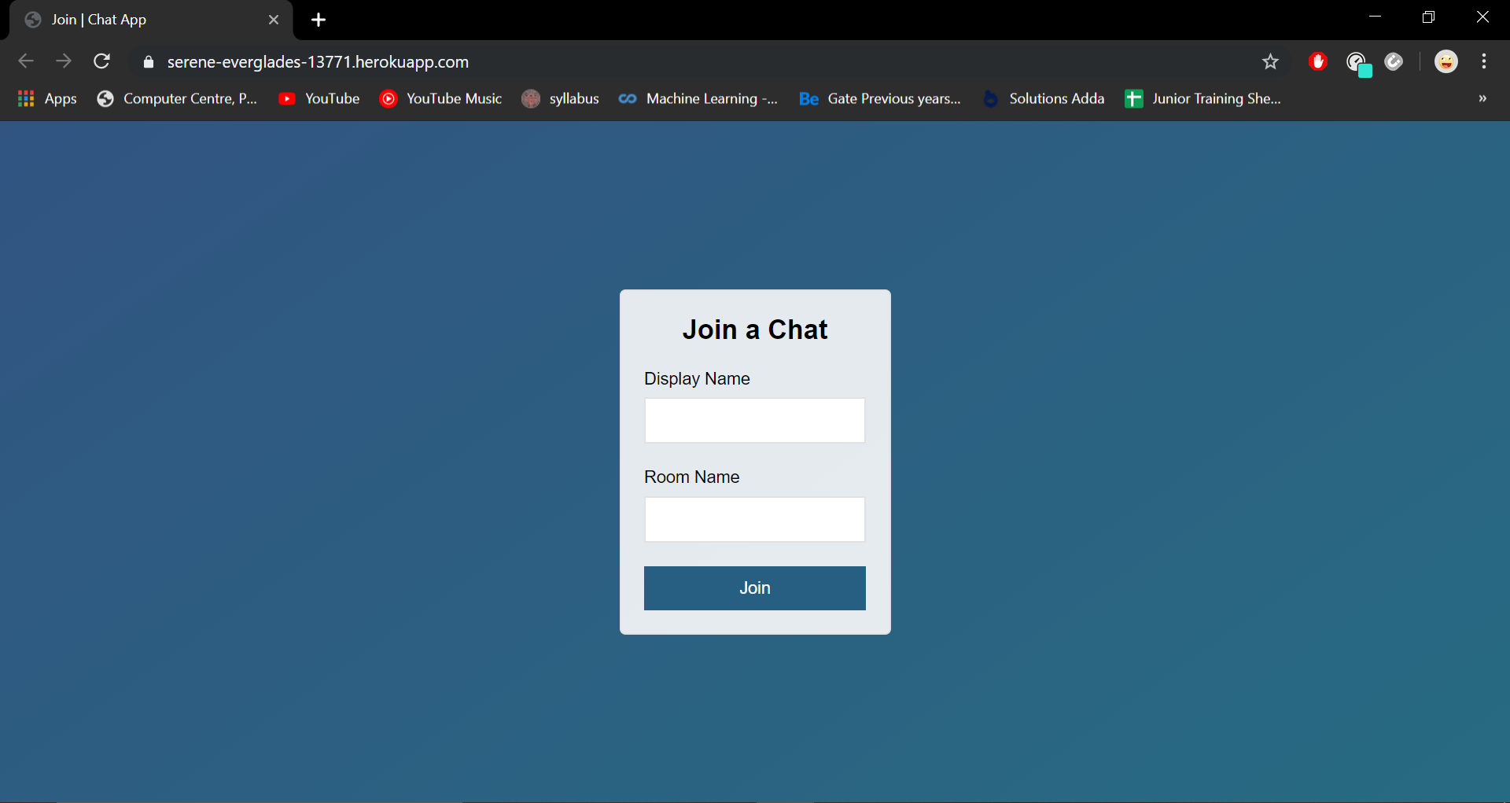
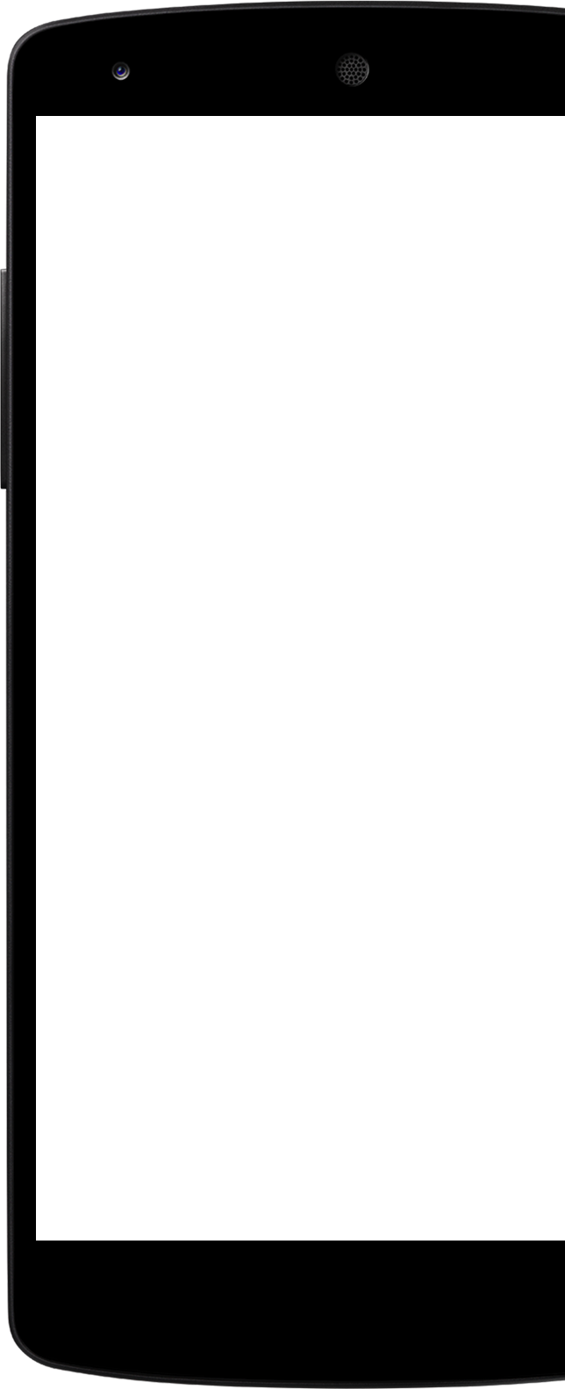
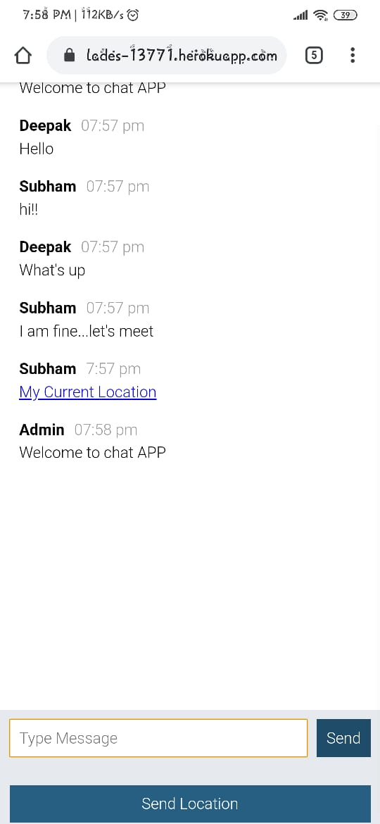
Node Chat App
Oops Info Solutions
Trainee as Back end developer

Slide 2
Outline
Project Overview
Objective
Project Development Architecture
Technologies Used
Future Scope
Conclusion

Slide 3
Project Overview
As the name suggests Node chat app is a chatting application which allows multiple users in a single room to chat with each other. Infinite users can join a single room and an user can connect to infinite rooms. Users can also share their current location in chat.

Slide 4
Objective
To develop a common platform where multiple users can chat at the same time.
Admin can create multiple rooms for multiple purposes .

Slide 5
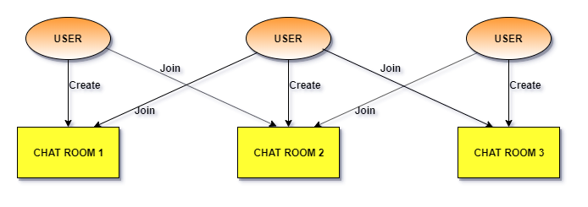
Project Development Architecture

Slide 6
Joining Screen (Desktop View)
User name and room name

Slide 7
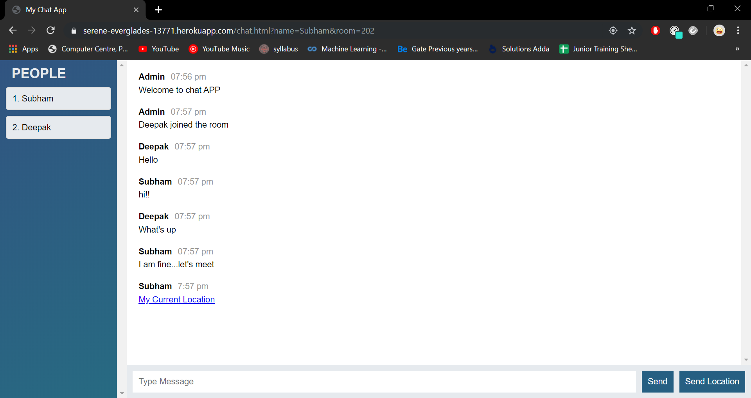
Component Detail
Chat Screen (Desktop View)
Location sharing option

Slide 8
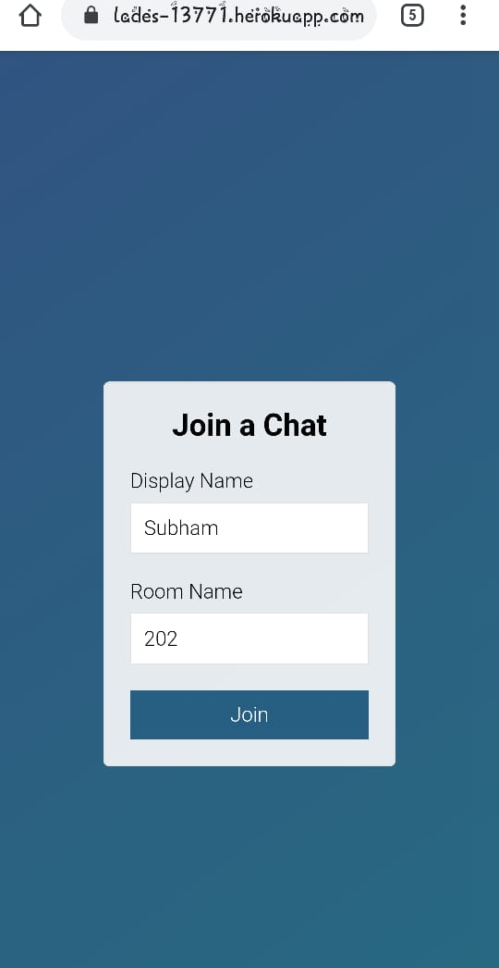
Component Detail (Mobile view)
Users can join an existing room or can create a new room.

Slide 9
Chat screen (Mobile View)
User can send current location

Slide 10






Technologies used:
HTML
CSS
Bootstrap
Javascript
Node.js.
Socket.io

Slide 11
What next? (Future Scope)
Increasing the effectiveness of the application by providing Voice Chat.
Introducing caching to save the chats.
Creating Database and maintaining users.
Media (photos, video) sharing support.
Extending security of the application by providing Authorisation service.

Slide 12
References
https://www.tutorialspoint.com/
https://www.w3schools.com/
https://developer.mozilla.org/en-US/
https://socket.io/

Slide 13
THANK YOU!

